Slide 1
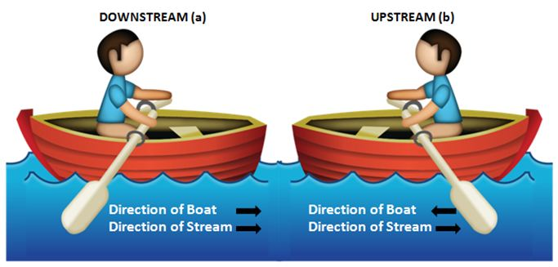
Boats and streams

Slide 2
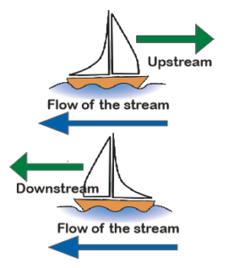

Slide 3
1. The speed of boat in still water is 20 kmph, speed of stream is 5 kmph. Find the upstream and down stream?
A) 15 kmph, 25 kmph B) 15 kmph, 30 kmph
C) 30 kmph, 45 kmph D) 15 kmph, 10 kmph
Notes:
A

Slide 4
2. The boat rowed downstream at 25.5 kmph and upstream at 12.5 kmph. The speed of stream is?
A) 2.5 kmph B) 5 kmph C) 6.5 kmph D) 7 kmph

Slide 5
3. A boat rowed downstream at 50 kmph and up stream at 32 kmph. The speed of boat is?
A) 41 kmph B) 21 kmph C) 45 kmph D) 25 kmph

Slide 6
4. A boat rowed downstream at 70 kmph and upstream at 46 kmph. The speed of man?
A) 52 kmph B) 58 kmph C) 62 kmph D) 68 kmph

Slide 7
5. A boat is rowed downstream at 120kmph and upstream at 80 kmph. The speed of current is
A) 20 kmph B) 25 kmph C) 30 kmph D) 35 kmph

Slide 8
6. A boat running downstream covers 45 km in 5 hours. While covering the same distance upstream it takes 9 hours. What is the speed of the boat?
A) 7 kmph B) 9 kmph C) 11 kmph D) 15 kmph

Slide 9
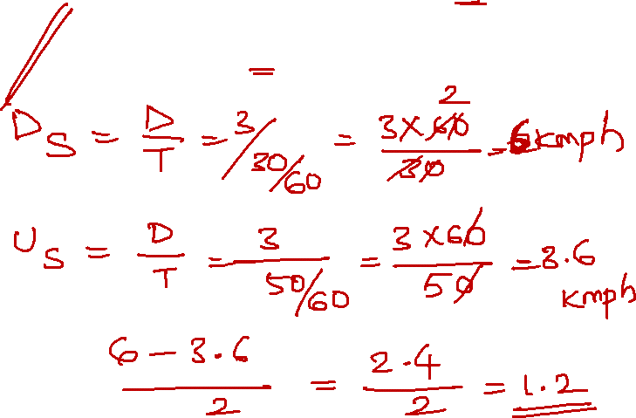
7. A boat can row 3 km with stream in 30 min and 3 km against the stream in 50 min. What is the speed of current?
A) 1.5 kmph B) 1.2 kmph C) 2 kmph D) 2.5 kmph

Slide 10
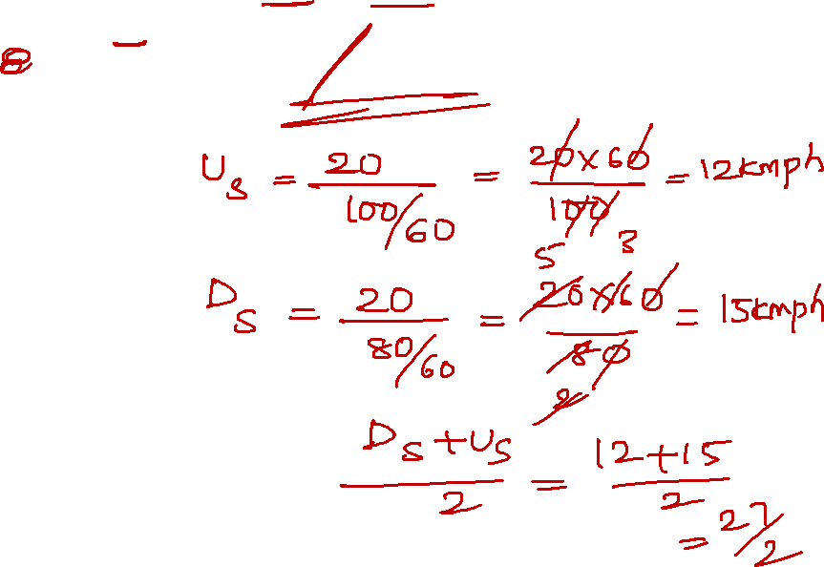
8. A fisherman can row 20km against the stream in 100 min and return in 80 min. What is the speed of boat?
A) 13.5 kmph B) 15 kmph C) 13.5 kmph D) 25 kmph

Slide 11
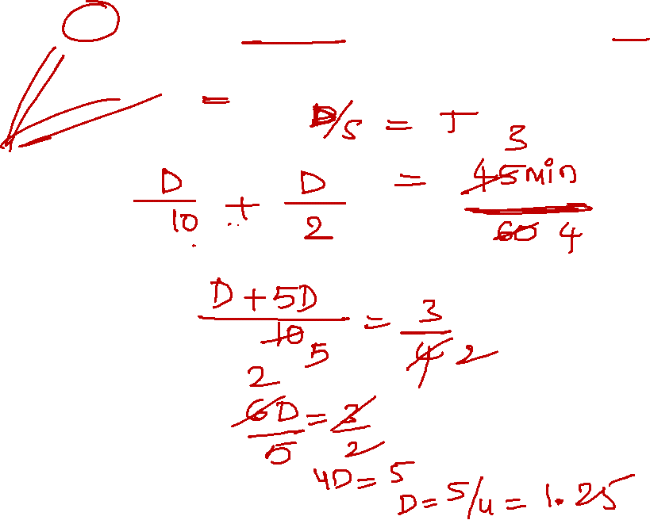
9. A man can row at 6 kmph in water if water is running at 4 kmph. It takes 45 min to row to place back. How far is the place?
A) 1.25 km B) 2 km C) 2.5 km D) 5 km

Slide 12
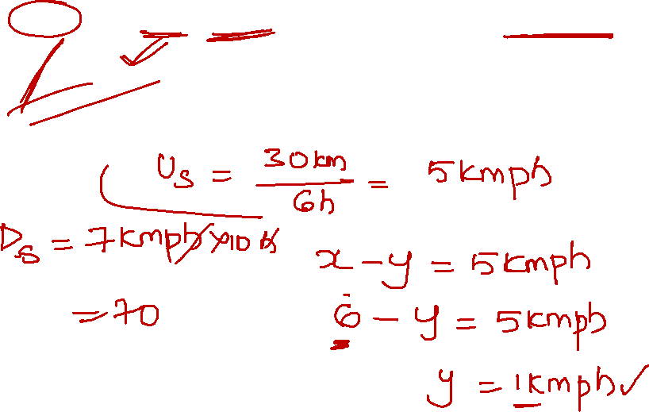
10.A man can row 30 km upstream in 6 hours. If the speed of the man in water is 6 kmph. Find how much he can row downstream in 10 hours
A. 70 km B. 140 km C. 200 km D. 250 km
Notes:
Upstream = (x-y) kmph= 30/6= 5 kmph
(6-y)= 5 kmph
Speed of current = 1 kmph
Speed of downstream (x+y)= 6+1=7 kmph
7*10= 70 km

Slide 13
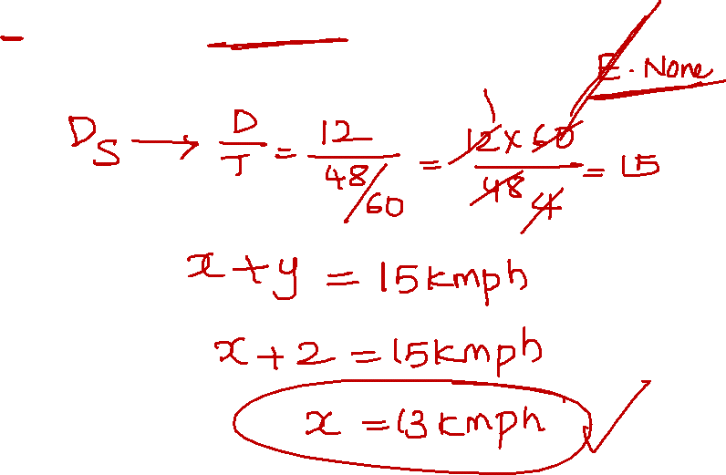
11. A boat goes 12 km downstream in 48 minutes. The speed of stream is 2 kmph. The speed of boat in still water is
A. 15 kmph B. 16 kmph C. 17 kmph D. 18 kmph
Notes:
Downstream = x-y kmph = 12km/ 48/60 = 12*60/48= 15 kmph
X-y= 15 kmph
X-2= 15
X= 17 kmph

Slide 14
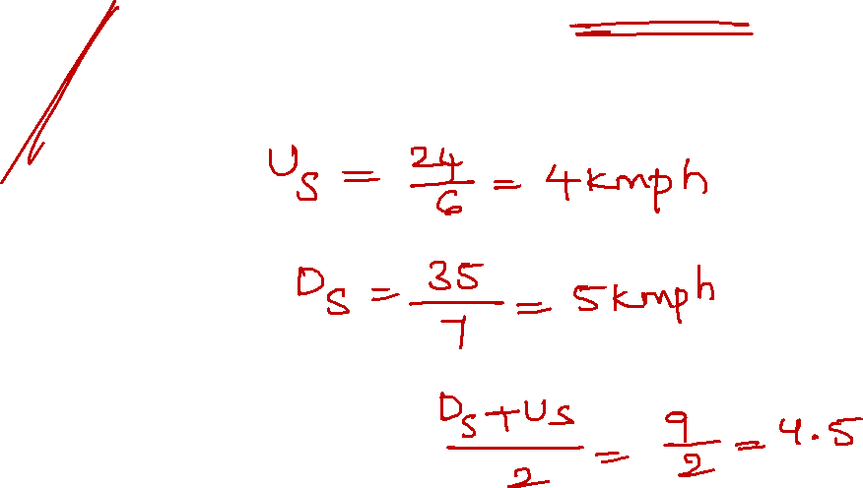
12. A man can row 24 km upstream in 6 hours and a distance of 35 km downstream in 7 hours. Then the speed of man in still water is
A. 4.5 kmph B. 4 kmph C. 5 kmph D. 5.5 kmph
Notes:
Up stream speed = 24/6 = 4 kmph
Down stream speed = 35/7 = 5 kmpjh
Speed of man in still water= 4+5/2 = 4.5 kmph

Slide 15
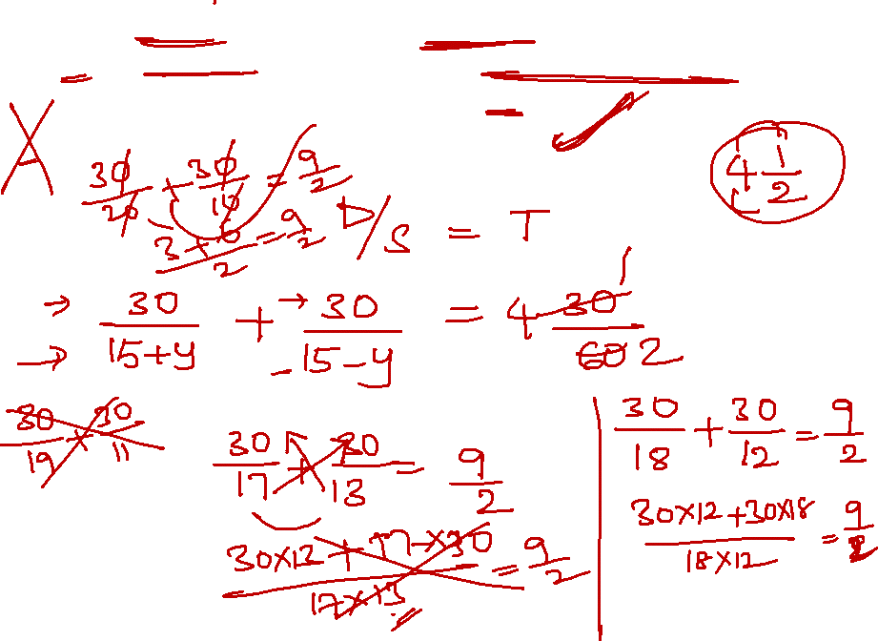
13. A speed boat, whose speed in 15kmph in still water goes 30km downstream and comes back in a total of 4 hours 30 minutes. What is the speed of the stream in kmph?
A. 2 kmph B. 3 kmph C. 4 kmph D. 5 kmph
Notes:
30/ 15+x + 30/ 15-x = 4(30/60)
Option D

Slide 16
14. A person can swim in water with a speed of 13 kmph in still water. If the speed of the stream is 4 kmph, what will be the time taken by the person to go 68km downstream
A. 2.5 hours B. 3 hours C. 4 hours D. 4.5 hours
Notes:
Down stream= x+y= 13+4= 17 kkmph
68/17 = 4 hrs

Slide 17
15. A streamer goes downstream from one part to another in 4 hours. It covers the same distance upstream in 5 hours. If the speed of stream is 2 kmph. The distance between the two ports is
A. 45 km B. 64 km C. 68 km D. 80 km
Notes:
D/(x+2) = 4 D/ (x-2) = 5
D= 4x+8 D= 5x-10
4x+8= 5x-10
18=x
Upstream = 18+2= 20*4 = 80

Slide 18


